Slide 1
PREDICTING PREGNANCY OUTCOMES
- SHAD CARLSON
- YOGESH REDDY

Slide 2
AGENDA
Problem Statement
Data-set
Literature Overview
ML in SGA
Descriptive Statistics
Next Steps
References

Slide 3
PROBLEM STATEMENT
Main focus:
Try to identify factors (maternal and environmental) that may be related with SGA births
Try to predict SGA births
Other pregnancy outcomes we might explore:
NICU admissions
Anomalies in newborns

Slide 4
DATA-SET
Data from an on-going prospective cohort – Maternal Antecedents of Adiposity and Studying the Transgenerational role of Hyperglycemia and Insulin (MAASTHI)
~ 750 data points with temporal data starting from the time the mother enrolled herself in the study till 24 hours after the delivery
PHI deleted as per HIPAA guidelines

Slide 5
LITERATURE OVERVIEW
SGA is a term used to describe babies who are smaller than usual for the number of weeks of pregnancy
How are they different from Low-Birth Weight (LBW) babies?
Initial research interest was focused on what are the risks, short-term and long-term outcomes of being born SGA
Now, with the help of predictive analysis, focus has shifted to predict and prevent SGA births

Slide 6
LITERATURE OVERVIEW
Birth weight and Gestational Age – two important variables that affect neonatal morbidity and mortality^{[1]}
Higher risks of developing growth and developmental disorders^{[2]}
Stunting
Undernourishment
Compromised cardiac function^{[3]}
Higher chances of nutrition-related chronic diseases (two-fold risk)^{[4]}

Slide 7
LITERATURE OVERVIEW
The DESiGN Trial (DEtection of Small for Gestational age Neonate)^{[5]}
Randomized Control Trial in UK (amongst the highest still birth rates of all developed countries)
Evaluating the effect of Growth Assessment Protocol (GAP) on early detection of SGA
GAP – an intervention that includes risk assessment for SGA and screening using customized fundal-height growth charts
Increased detection of SGA -> Reduction of stillbirth rates by 22%

Slide 8
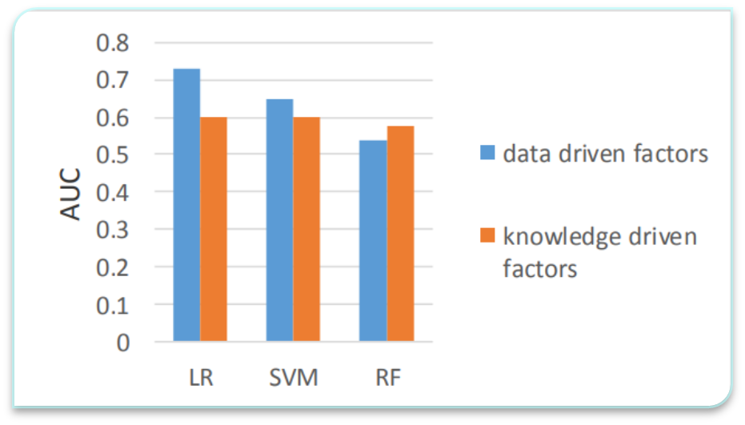
ML IN SGA
One study studied the use of machine learning in predicting children at risk of SGA^{[6]}
A Support Vector Machine model outperformed a Logistical Model and a Random Forests Model in one study

Slide 9
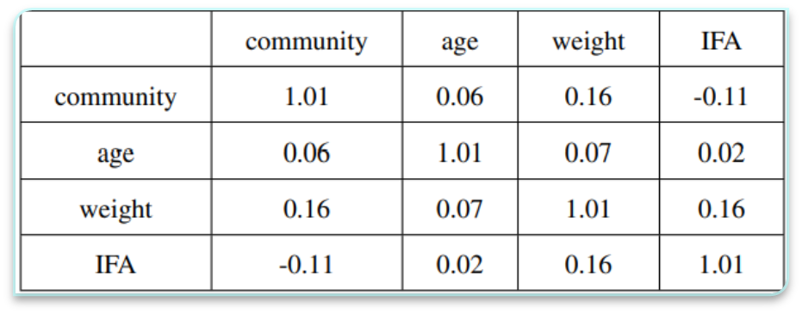
ML IN SGA
A Study in 2017 used a Bayesian Network to predict low birth weight^{[7]}
They found that Community, Age, Weight, and intake of iron and folic acid for the mother best predicted low birth weight

Slide 10
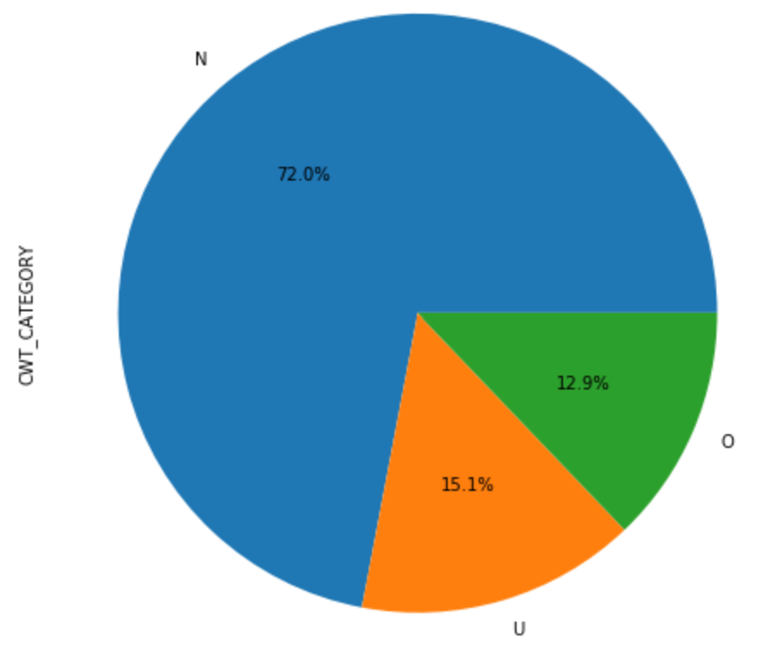
DESCRIPTIVE STATISTICS
Outcome = Child Weight Category
N = Normal (72%)
O = Large for gestational age (12.9%)
U = Small for gestational age (15.1%)
Uneven distribution
Why is that a problem?

Slide 11
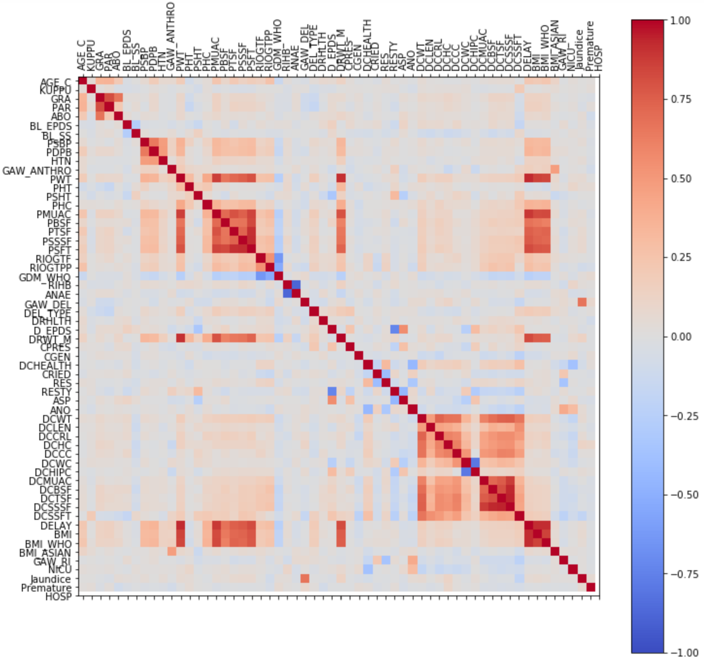
NEXT STEPS
~ 60 features
Many features are highly correlated
How will that affect our results?
Possible solutions?

Slide 12
QUESTIONS?

Slide 13
References
Tunny Sebastian, Bijesh Yadav, Lakshmanan Jayaseelan, Reeta Vijayaselvi & Ruby Jose; “Small for gestational age births among South Indian women: temporal trend and risk factors from 1996 to 2010”; BMC Pregnancy and Childbirth 15, article number: 7 (2015) https://doi.org/10.1186/s12884-015-0440-4
Blake RA, Park S, Baltazar P, Ayaso EB, Monterde DBS, Acosta LP, et al. (2016) LBW and SGA Impact Longitudinal Growth and Nutritional Status of Filipino Infants. PLoS ONE 11(7): e0159461. https://doi.org/10.1371/journal.pone.0159461
Manish Kumar, Sridhar Santhanam, Niranjan Thomas & Atanu Kumar Jana (2019) A prospective observational study comparing cardiac function of small for gestational age with appropriate for gestational age babies using serial echocardiographic studies, The Journal of Maternal-Fetal & Neonatal Medicine, 32:13, 2194-2199, DOI: 10.1080/14767058.2018.1429392
https://www.who.int/nutrition/healthygrowthproj_stunted_videos/en/
https://doi.org/10.1186/s13063-019-3242-6
J. Sun et al., "A data-driven approach to predict Small-for-Gestational-Age infants," 2016 IEEE 13th International Conference on Networking, Sensing, and Control (ICNSC), Mexico City, 2016, pp. 1-6. http://ieeexplore.ieee.org/stamp/stamp.jsp?tp=&arnumber=7479016&isnumber=7478962
A. R. Yarlapati, S. Roy Dey and S. Saha, "Early Prediction of LBW Cases via Minimum Error Rate Classifier: A Statistical Machine Learning Approach," 2017 IEEE International Conference on Smart Computing (SMARTCOMP), Hong Kong, 2017, pp. 1-6. http://ieeexplore.ieee.org/stamp/stamp.jsp?tp=&arnumber=7947002&isnumber=7946954

